Slide 1
Slide Rule for Fire Fighting Sprinklers
from Mather & Platt Ltd. / by J. Halden and Co. Ltd. (both UK)
Picture: Anonymous; https://creazilla.com/nodes/25947-fire-clipart; Public Domain License

Slide 2
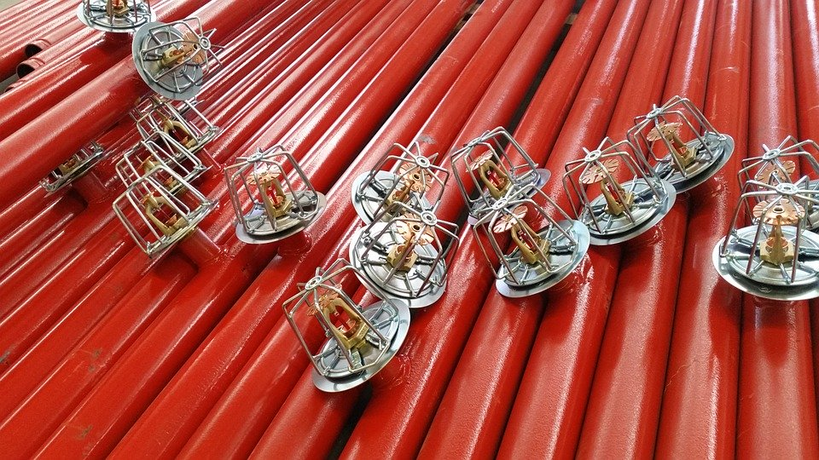
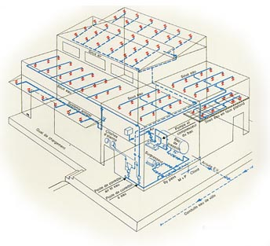
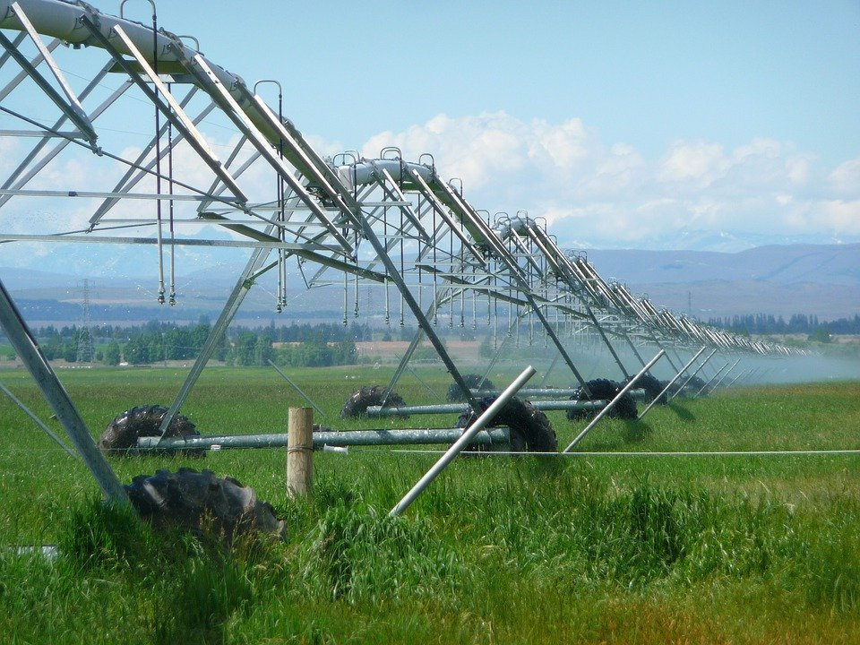
What for?
Photo: Brandon Leon / CC BY-SA
Photo: Claudio Losa / Pixabay
https://sites.google.com/site/historyofmatherplattltd/
Photo: Siggy Nowak / Pixabay

Slide 3
The Slide Rule
≈ 19‘‘ / 48cm
≈ 1/2‘‘ / 12mm

Slide 4
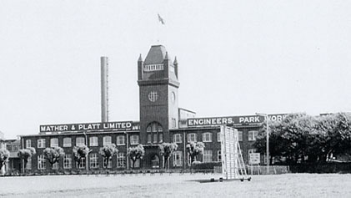
Salford Iron Works (Collin and William Platt)
Mather Textile Machines (William and Collin Mather)
≈ 1852: Mather & Platt Ltd.
Textile Machines
Pumps
Electrical Equipment
Fire Engineering
Chemical Systems
https://sites.google.com/site/historyofmatherplattltd/

Slide 5
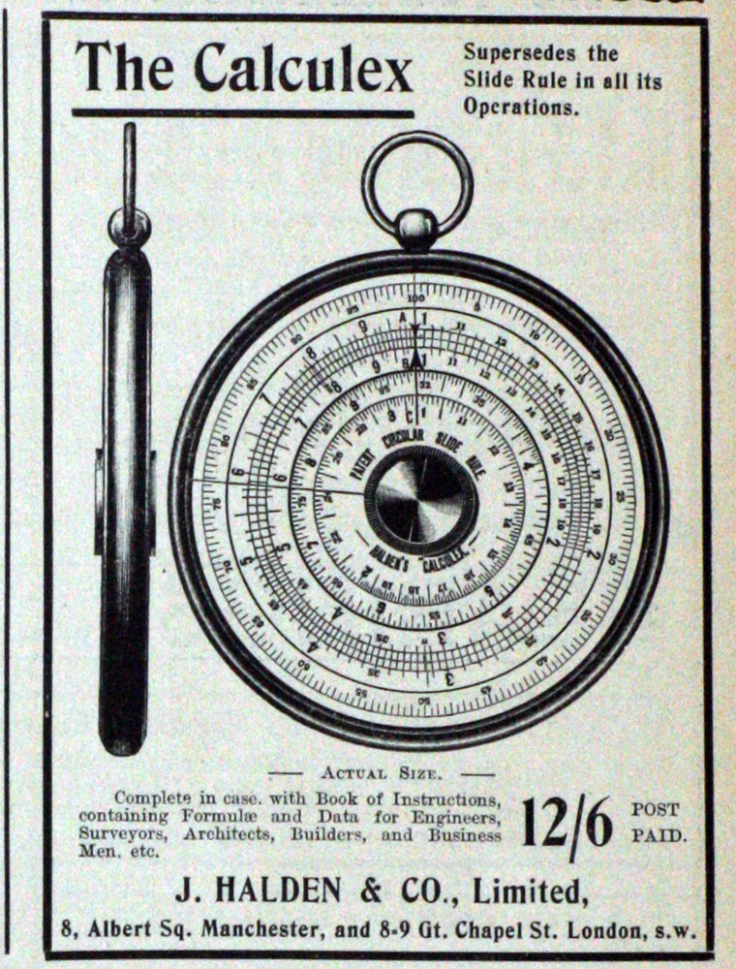
J. Halden & Co. Ltd.
Drawing Office Materials
Photo Processes
https://www.gracesguide.co.uk/File:Im19071214Loco-Halden.jpg

Slide 6
3 Steps do design a Sprinkler System
2
h = Δp/(ρ·g)
Pressure / Head loss
Pressure grade line
$$\frac{p_{0}}{ρ∙g}$$
Initial pressure head
$$\frac{p_{i}}{ρ∙g}$$
Local pressure head
Sprinkler pipe
P
Q_{total} = ΣQ_{i}
Q_{i}
3
1
1
Determine the required discharge (per area and/or per sprinkler) and from this the total discharge
Compute the pressure head loss and therefrom the local pressure head at each sprinkler and the required initial pressure head
Choose adequate type of sprinkler
2
3

Slide 7
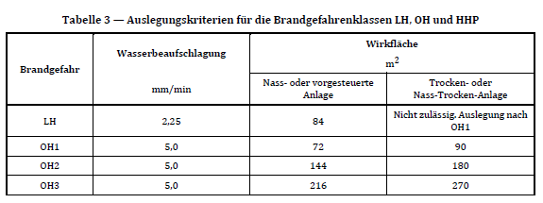
Water Demand
1
2a
2b
3
Q_{sprinkler}
A_{sprinkler}

Slide 8
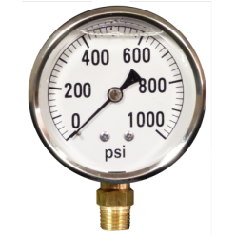
Friction Head Loss
1
2a
2b
3
Length (L)
Friction head loss (h_{f})
Initial pressure head
Local pressure head
Discharge (Q)
Diameter (D)
Roughness (C)
$$h_{f}=const∙\frac{L}{D^{4.87}}∙\frac{Q^{1.85}}{C^{1.85}}$$
Hazen-Williams
Combined scale
$$Δp=const∙ρ·g·\frac{L}{D^{4.87}}∙\frac{Q^{1.85}}{C^{1.85}}$$
or

Slide 9
An Example
1
2a
2b
3
GPM = (US) gallons per minute
L = 40 ft
Q = 17.5 GPM
D = 1 inch (steel) (D^{4.87} ·C^{1.85})
Δp = 3.8 psi
1 ft = 0.434 psi
Δp = 3.8 psi
h_{f} = 8.8 ft

Slide 10
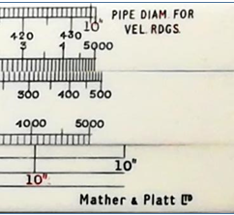
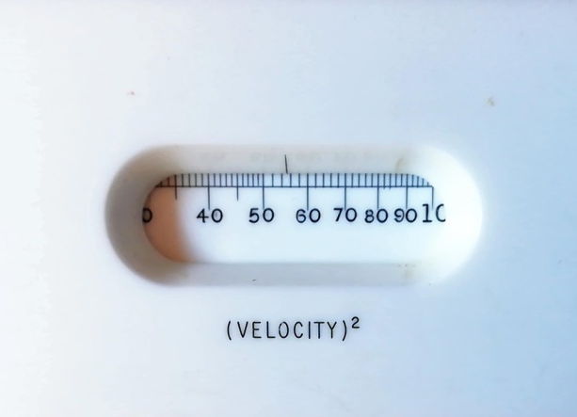
The Flow Velocity
1
2a
2b
3
v = 7.4 ft/s
D = 1 inch
Q = 17.5 GPM
v² = 55 (ft/s)²
$$v=\frac{Q}{A}=\frac{Q}{{π·D}^{2}/4}$$

Slide 11
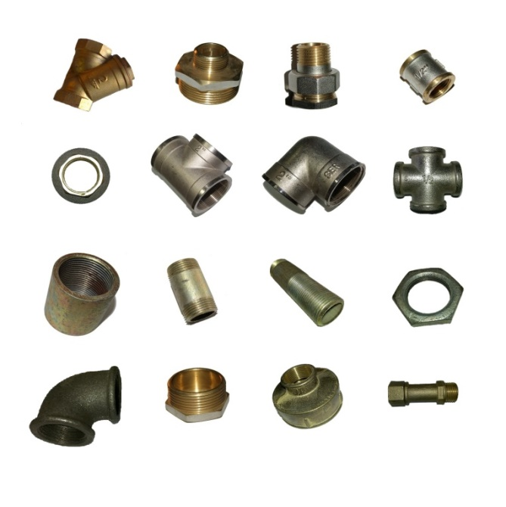
Local Head Losses
1
2a
2b
3
$${Friction head loss h}_{f}=const∙\frac{L}{C^{1.85}}∙\frac{Q^{1.85}}{D^{4.87}}$$
$${Local head loss h}_{L}=x∙\frac{v^{2}}{2g}$$
Bends
Bifurcation
Fittings
Valve
Луносвет, CC BY-SA-3.0

Slide 12
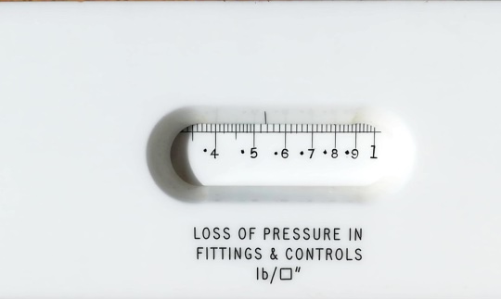
Local Head Losses
1
2a
2b
3
$$x∙\frac{v^{2}}{2g}$$
2g = 64.4 ft/s²
L (ft) Δp (psi)
v²/2g = 0.86 ft
v² = 55 (ft/s)²
e.g. with x = 1.45 → h_{L} = 1.25 ft or Δp = 0.54 psi
Q = 17.5 GPM
Δp = 0.54 psi
1 inch

Slide 13
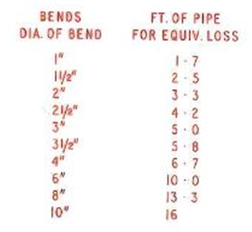
Equivalent Length for Bends
1
2a
2b
3
$$h_{f}=f∙\frac{L_{e}}{D^{4.87}}∙\frac{Q^{1.85}}{C^{1.85}}$$
$$h_{L}=x∙\frac{v^{2}}{2g}$$
equivalent lenght L_{e} ≈ 20∙d
d

Slide 14
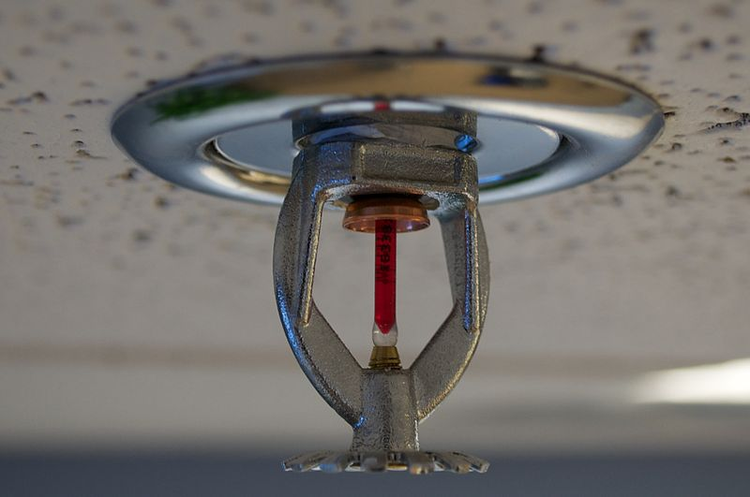
Sprinkler Discharge
1
2a
2b
3
Q_{i}$=K∙\sqrt{p_{i}}$
Photo: Claudio Losa / Pixabay
Catalogue Tyco Fire Protection Products, from www.grinnell.com

Slide 15
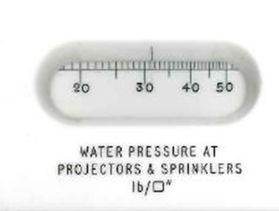
Sprinkler Discharge
1
2a
2b
3
p_{i} = 31.5 psi
Q_{i}$=K∙\sqrt{p_{i}}$
Q_{i} = 23 GPM
K = 4.2

Slide 16
That‘s It
Thank you for your attention
&
thank you Phillip, for providing us this extraordinary slide rule
Here you will find more slide rules for hydraulic engineers
https://prof.beuth-hochschule.de/heimann/rechenschieber-fuer-das-bauwesen/wasserbau-hydraulic-engineering/?print=1
heimannstefan@yahoo.de

